Slide 1
HIS 104 WORLD HISTORY
1500 to PRESENT

Slide 2
CAPITALISM & EUROPE
Mercantilism:-
Meaning: Ideology of stealing raw materials from colonies and processing them into finished goods in Europe.
Examples: Sugar, Tobacco, Cocoa, Cotton, etc.
How It Worked: Colony > Europe > Colony and the rest of the world.

Slide 3
Mercantilism
Benefits of mercantilism to Europeans
Job Creation in Europe
Tax on goods, factories, and factory workers
Cheap raw material, expensive finished products.
Trade monopoly

Slide 4
CAPITALISM
An economic system that has profit-making and regular increase in profit margin as its goals.
Private sector driven
The government provides necessary assistance to enable the rich to get richer.
For example:- laws, tax loopholes, security, infrastructure, etc.

Slide 5
CAPITALISM & SLAVERY
To maximize profit, Europeans turned Africans into machines
Acquired insurance on them
Bred them like chicken, Branded them
Humiliated them (Buck-Breaking) to make them afraid of white people, hence “Uncle-Toms.”
Had white overseers (modern-day supervisors).
Destroyed the mind, while controlling the body.

Slide 6
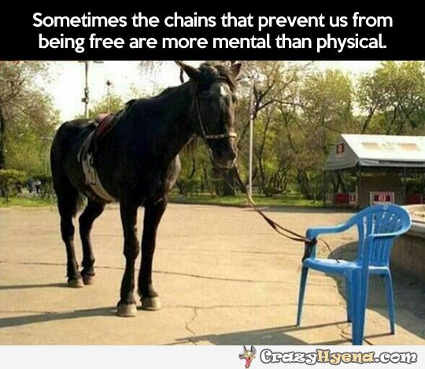
CAPITALISM & SLAVERY

Slide 7
CAPITALISM & SLAVERY
Consequences:-
Slave mentality – low self-esteem(dislike for Africa, snitching, bleaching, perming)
Desire to be with the slave master: schools, neighborhoods, sports.
Business: work rather than own.

Slide 8
Critique of Modern-Day Capitalism
Exploitative: The rich uses their wealth to exploit the labor of the working class;
Materialistic: All that matters is material possession and astronomic profit-making;
Creates Economic Inequality & Social Stratification;
Commodifies People (Consumers, Spending, Advertising Control);
Capitalism produces & thrives in Monopoly;
Erodes Democracy: Big Money donation to politicians and lobby typifies corporate corruption.

